Slide 1
Sinusoidal Oscillators

Slide 2
Positive and Negative Feedback
Negative feedback
feedback signal is opposite in polarity to the input signal
this leads to a net decrease in the input signal
results in a reduced gain at the output.
also called degenerative or inverse feedback.
used in amplifiers to improve the stability, and reduce distortion
Positive feedback
feedback signal is of same polarity as the input signal
the effective input to the circuit is increased
Results in increased gain at the output
also called positive, regenerative or direct feedback.
increases distortion and leads to poor stability
used in oscillators where it is needed to sustain the oscillations in the output.

Slide 3
Feedback
When a part of output signal is fed back to the input through a suitable circuit, the process is called feedback.
Feedback is of two types: positive feedback and negative feedback
For example, positive feedback can be compared to the following cycle:
1) You study hard, and your grades improve. 2) As your grades improve, studying becomes more enjoyable, and you study more. 3) Your grades improve further.
In other words, positive feedback is a process that further increases the effects of a small change in output.
In contrast, negative feedback can be compared to the following cycle:
1) You study hard, and your grades improve. 2) You spend less time studying and more time relaxing. 3) Your grades drop. 4) You spend less time relaxing and more time studying. 5) Your grades get back to the previous level.
It is a process of trying to keep the output (i.e., your grades in this example) constant. This process is called negative feedback.

Slide 4
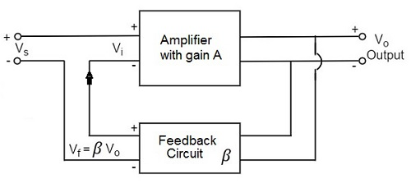
Principle of Feedback Amplifier
feedback voltage V_{f} is added to signal voltage V_{s} for
positive feedback
Vi=Vs+Vf=Vs+βVo
feedback voltage V_{f} is subtracted from signal voltage V_{s} for
negative feedback
Vi=Vs−Vf=Vs−βVo
The output voltage for both feedbacks is given by
Vo=AVi

Slide 5
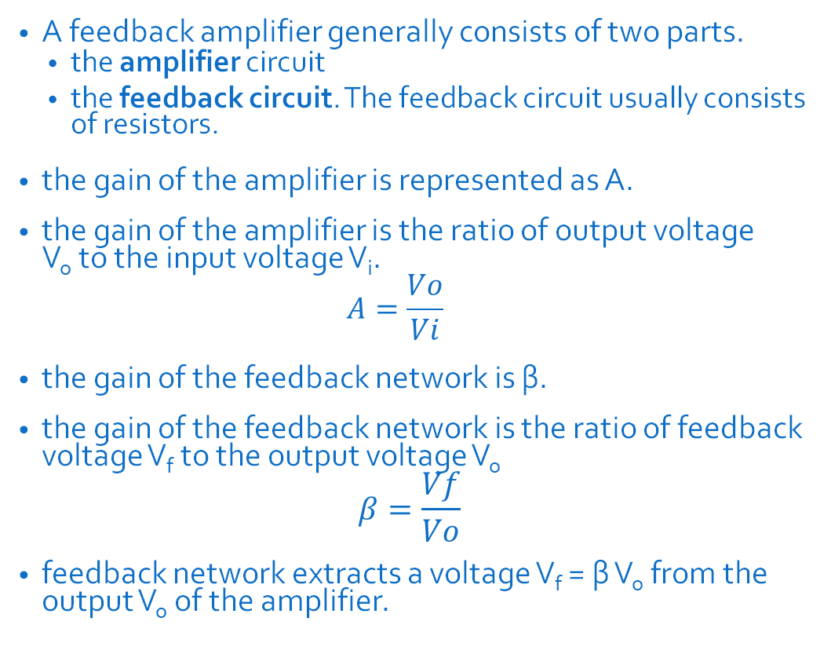
Principle of Feedback Amplifier
A feedback amplifier generally consists of two parts.
the amplifier circuit
the feedback circuit. The feedback circuit usually consists of resistors.
the gain of the amplifier is represented as A.
the gain of the amplifier is the ratio of output voltage V_{o} to the input voltage V_{i}.
$$A=\frac{Vo}{Vi}$$
the gain of the feedback network is β.
the gain of the feedback network is the ratio of feedback voltage V_{f} to the output voltage V_{o}
$$β=\frac{Vf}{Vo}$$
feedback network extracts a voltage V_{f} = β V_{o} from the output V_{o} of the amplifier.

Slide 6

Positive Feedback Amplifier
The output voltage is given by
Vo=AVi
Foe positive feedback, Vi = Vs+βVo
Hence,
Vo = A (Vs + βVo)
AVs + AβVo = Vo
AVs = Vo (1 - Aβ)
$$∴ \frac{Vo}{Vs}=\frac{A}{1−Aβ}$$

Slide 7


Positive Feedback Amplifier
Let A_{f} be the overall gain (gain with the feedback) of the amplifier.
The overall gain is defined as the ratio of output voltage V_{o} to the applied signal voltage V_{s} , i.e.,
So, from the above two equations, we can understand that, the equation of gain of the feedback amplifier, with positive feedback is given by
The product Aβ is called the loop gain or feedback factor.

Slide 8
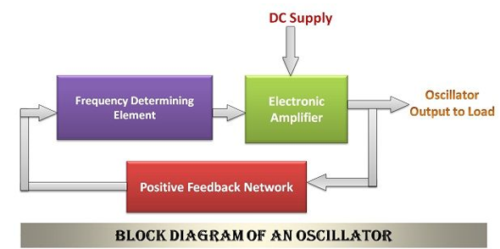
Oscillator
Oscillator is a circuit which utilizes positive feedback amplifier to generate sinusoidal waveforms of fixed amplitude and frequency.
It is the major source of power in electrical and electronic instruments.
The oscillator can generate the sinusoidal output signal even in the absence of any input, i.e Vs = O. It utilizes the feedback signal as the input signal

Slide 9
Principle of Oscillator and Barkhausen Criterion
The principle of the oscillator is that when the feedback factor or the loop gain is one, then the overall gain of the oscillator circuit will be infinite.
This implies that even when there is no input then also the oscillator will continue to generate the output.
We know that for positive feedback, overall gain is given by
If Aβ = 1, then A_{f} = ∞
It means that even without giving any input, output can be obtained.
This principle is utilized in oscillators, and is called the Barkhausen Criterion.

Slide 10
Barkhausen Criterion
Barkhausen criterion states that :
The total phase shift around a loop as the signal proceeds from input through the amplifier, feedback network, and back to the input again, completing a loop, is precisely 0° or 360°
The magnitude of the product of the open loop gain of the amplifier (A) and the feedback factor β is unity i.e. |Aβ|=1
If these conditions are satisfied, the circuit works as an oscillator producing sustained oscillations of constant frequency and amplitude.
In theory, no input is needed to start the oscillation.
In practice, Aβ>1 to start the oscillation and then circuit adjust itself to get Aβ=1, finally resulting into self-sustained oscillations.

Slide 11
COLPITT’S OSCILLATOR

Slide 12
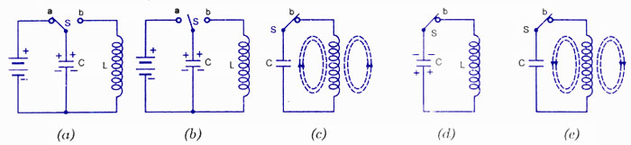
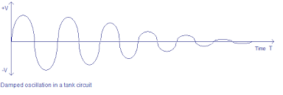
Tank circuit
Oscillators consist of a tank circuit along with amplifier.
A tank circuit consists of a capacitor in series/parallel with an inductor
Assume the capacitor is fully charged, and has stored electrostatic energy.
It discharges, and the current flows through the inductor.
Electrostatic energy gets converted to electromagnetic energy in inductor.
After fully discharging, capacitor gets charged again in reverse polarity using electromagnetic energy from inductor.
Cycle continues, producing sine waves.

Slide 13

Tank circuit
Oscillations happen when the circuit is in resonance
i.e. when inductive reactance X_{L} = capacitive reactance X_{C}
i.e. 2πfL = 1/2πfC
i.e. f$=\frac{1}{2π\sqrt{LC}}$
f is called the resonant frequency or frequency of oscillation

Slide 14
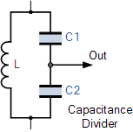
Colpitt’s oscillator
Colpitts Oscillator was designed by and named after an American Engineer Edwin H Colpitts in 1918.
The Colpitts Oscillator design uses two centre-tapped capacitors in series with a parallel inductor to form its resonance tank circuit producing sinusoidal oscillations
The Colpitts oscillator uses a capacitive voltage divider network as its feedback source.
The two capacitors, C1 and C2 are placed across a single common inductor, L as shown.
Then C1, C2 and L form the tuned tank circuit with the condition for oscillations being: X_{C1} + X_{C2} = X_{L}

Slide 15
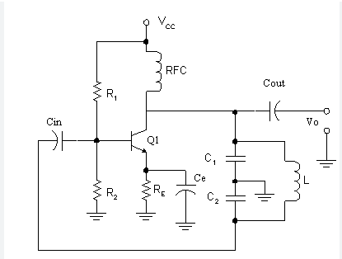
Colpitt’s oscillator
The Colpitt’s oscillator uses a single stage bipolar transistor amplifier as the gain element which produces a sinusoidal output.
The emitter terminal of the transistor is effectively connected to the junction of the two capacitors, C1 and C2 which are connected in series and act as a simple voltage divider.
When the power supply is first applied, capacitors C1 and C2 charge up and then discharge through the coil L.
The oscillations across the capacitors are applied to the base-emitter junction and appear in the amplified form at the collector output.
Resistors, R1 and R2 provide the usual DC bias for the transistor in the normal manner
The additional capacitors act as a DC-blocking bypass capacitors.
A radio-frequency choke (RFC) is used in the collector circuit to provide a high reactance to AC (ideally open circuit) at the frequency of oscillation ( ƒ ), and a low resistance at DC to help start the oscillations.

Slide 16


Colpitt’s oscillator
The amount of feedback is determined by the ratio of C1 and C2
The frequency of oscillations for a Colpitt’s oscillator is determined by the resonant frequency of the LC tank circuit and is given as:
where C_{T} is the capacitance of C1 and C2 connected in series and is given as:

Slide 17
Hartley oscillator

Slide 18
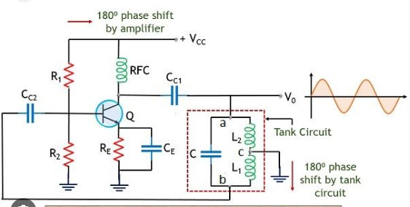
Hartley Oscillator circuit and working
The voltage at point X (collector), relative to point Y (emitter), is 180º out-of-phase with the voltage at point Z (base) relative to point Y.
There is already a 180º phase change in the voltage between the Base and Collector
So the total phase shift in the amplifier + feedback path is equal to 180º + 180º = 360º .
Thus, positive feedback for oscillations is maintained.

Slide 19
Hartley Oscillator circuit and working
The amount of feedback depends upon the position of the “tapping point” of the inductor.
If this is moved nearer to the collector the amount of feedback is increased
Resistors, R1 and R2 provide the usual stabilizing DC bias for the transistor in the normal manner while the capacitors act as DC-blocking capacitors.

Slide 20
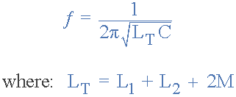
Hartley Oscillator circuit and working
The frequency of oscillation is given by
where M is the mutual inductance between L1 and L2.

Slide 21
Rc phase shift oscillator

Slide 22
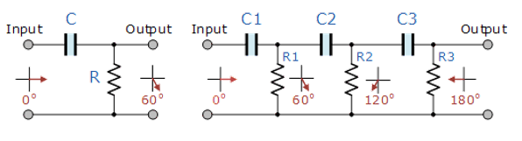
RC phase shifting circuit
Resistor-capacitor (RC) networks around the transistor are used to provide the required positive feedback without the need for a tank circuit.
In an RC Oscillator circuit, the input is shifted 180º through the feedback circuit.
Transistor amplifier can produce 180º of phase shift between its output and input signals
So the total phase shift in the amplifier + feedback path is equal to 180º + 180º = 360º .
Thus, positive feedback for oscillations is maintained.

Slide 23
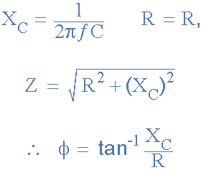
RC phase shifting circuit
Equations for phase shift in RC circuit:

Slide 24
RC phase shifting circuit
The values of R and C have been chosen so that at the required frequency, the output voltage leads the input voltage by an angle of about 60º
Then the phase angle between each successive RC section increases by another 60º giving a phase difference between the input and output of 180º (3 x 60º)
So by cascading together three such RC networks in series we can produce a total phase shift in the circuit of 180º at the chosen frequency
This forms the bases of a “RC Oscillator” otherwise known as a Phase Shift Oscillator as the phase angle is shifted by an amount of 60º through each stage of the circuit.

Slide 25
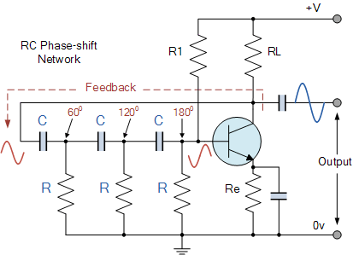
RC phase shift oscillator
The basic RC Oscillator which is also known as a Phase-shift Oscillator, produces a sine wave output signal using regenerative or positive feedback obtained from the resistor-capacitor (RC) network.
By varying one or more of the resistors or capacitors in the phase-shift network, the frequency can be varied

Slide 26

RC phase shift oscillator
The frequency of oscillations produced by the RC oscillator is simply given as:
Where:
ƒ_{r} is the oscillators output frequency in Hertz
R is the feedback resistance in Ohms
C is the feddback capacitance in Farads
N is the number of RC feedback stages.
This is the frequency at which the phase shift circuit oscillates.
Since the number of stages is given as three, so N = 3,
So (√2*3 = √6)

Slide 27
Wien bridge oscillator

Slide 28
Introduction
Wien Bridge Oscillator is an oscillator which uses RC network so as to produce a sine wave at the output.
It is basically a low-frequency oscillator that generates audio and sub audio frequency that ranges between 20 Hz to 20 KHz.
This oscillator circuit uses the Wien bridge to provide feedback with the desired phase shift.
It gives highly stable oscillation frequency and does not vary much with supply or temperature variation.

Slide 29
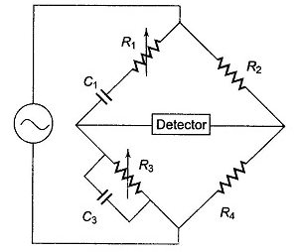

Wien’s bridge
Wien’s bridge is a R-C bridge circuit.
It is a frequency selective circuit.
It allows signal of only one particular frequency to pass through it.
This frequency is called the resonant frequency of the bridge, and is given by
This frequency is that at which Wien bridge is balanced and for which the phase shift between input and output is 0°.

Slide 30
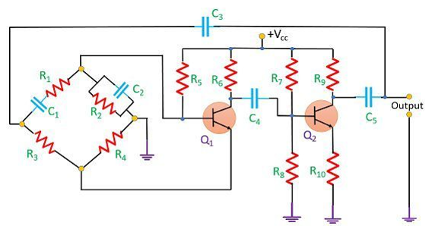
Wien bridge oscillator
The circuit mainly comprised of two transistors Q1 and Q2 and Wien bridge circuit
The transistor Q1 serves as an oscillator and an amplifier while the other transistor Q2 serves as an inverter.
The inverter operation provides a phase shift of 180°
Wien bridge is employed so that signal of a particular frequency only is given to the amplifier.
Because of this, the oscillator is able to produce sustained oscillations of a particular frequency.
Wien bridge gives frequency stability to the oscillator.

Slide 32

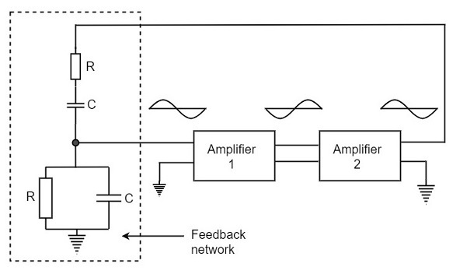
Wien bridge oscillator
The frequency of oscillation is given by
When the circuit is switched ON, the bridge circuit produces oscillations of the frequency stated above.
The two transistors produce a total phase shift of 360° so that proper positive feedback is ensured
Simplified circuit

Slide 33
Crystal oscillator

Slide 34
Introduction
Crystal oscillators operate on the principle of inverse piezoelectric effect
Inverse piezoelectric effect: phenomenon in which an alternating voltage applied across the crystal surfaces causes it to vibrate at its natural frequency.
It is these vibrations which eventually get converted into oscillations.
These oscillators are usually made of Quartz crystal, even though other substances like Rochelle salt and Tourmaline exhibit the piezoelectric effect
Quartz is inexpensive, naturally-available and mechanically-strong when compared to others.

Slide 35
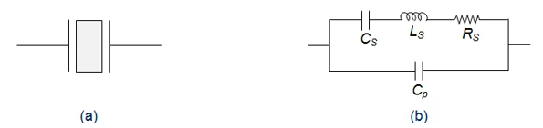
Construction of crystal and its behaviour
In crystal oscillators, the crystal is suitably cut and mounted between two metallic plates as shown by Figure (a)
Its electrical equivalent is shown by Figure (b).
In reality, the crystal behaves like a series RLC circuit, formed by the components
A low-valued resistor R_{S}
A large-valued inductor L_{S}
A small-valued capacitor C_{S}
A parallel electrode capacitance C_{p}.

Slide 36

Construction of crystal and its behaviour
Due to the presence of C_{p}, the crystal will resonate at two different frequencies viz.,
Series Resonant Frequency, f_{s} which occurs when the series capacitance C_{S} resonates with the series inductance L_{S}.
Mathematical expression for the series resonant frequency is given as

Slide 37

Construction of crystal and its behaviour
Parallel Resonant frequency, f_{p} which occurs when L_{S} and C_{S} resonate with C_{p}.
expression for the parallel resonant frequency is given as
Hence, we need to tune the circuit for any one among these two.

Slide 38
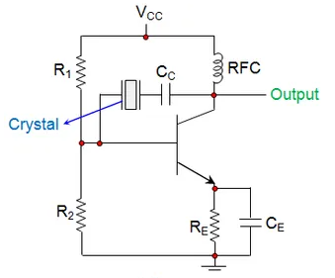
Crystal oscillator
The resistors R₁ and R₂ form the voltage divider network while the emitter resistor R_{E} stabilizes the circuit.
Further, C_{E} acts as an AC bypass capacitor while the coupling capacitor C_{C} is used to block DC signal propagation between the collector and the base terminals.
Radio Frequency Coil (RFC) in the circuit provides the DC bias.

Slide 39
Crystal oscillator
The frequency of the crystal oscillators will be fixed to be the crystal’s fundamental or characteristic frequency which will be decided by the physical size and shape of the crystal.
The typical operating range of the crystal oscillators is from 40 KHz to 100 MHz

Slide 40
Crystal oscillator
The frequency of oscillations generated by the circuit is decided by the resonant frequency of the crystal
It will be unaffected by the variations in supply voltage, transistor parameters, etc.
As a result, crystal oscillators exhibit excellent frequency stability, making them most suitable for high-frequency applications.
However, care should be taken so as to operate the crystal with optimum power only.
This is because, if too much power is delivered to the crystal, it leads to the unstable resonant frequency.

Slide 41
Crystal oscillator
Crystal oscillators are compact in size and are of low cost due to which they are extensively used in electronic warfare systems, communication systems, guidance systems, microprocessors, microcontrollers, space tracking systems, measuring instruments, medical devices, computers, digital systems, instrumentation, phase-locked loop systems, modems, sensors, disk drives, marine systems, telecommunications, engine control systems, clocks, Global Positioning Systems (GPS), cable television systems, video cameras, toys, video games, radio systems, cellular phones, timers, etc.

